Slide 1
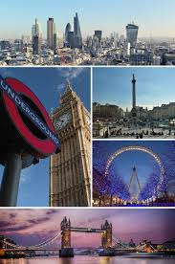
LONDON’S LANDMARKS

Slide 2
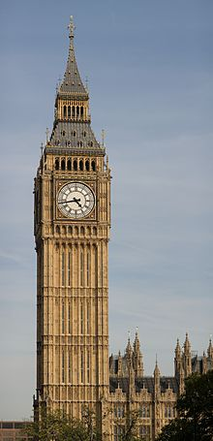
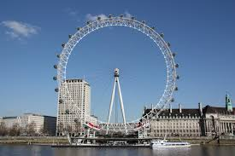
LANDMARKS
Big ben
London eye

Slide 3
BIG BEN
Big Ben is the nickname for the Great Bell of the clock at the north end of the Palace of Westminster in London and is usually extended to refer both the clock and the clock tower. The tower was designed by Augustus Pugin in a neo-gothic style. When completed in 1859, its clock was the largest and most accurate four-faced striking and chiming clock in the world. The tower stands 315 feet (96 m) tall, and the climb from ground level to the belfry is 334 steps. Big Ben is the largest of five bells and weighs 13.5 long tons. It was the largest bell in the United Kingdom for 23 years. The origin of the bell's nickname is open to question; it may be named after Sir Benjamin Hall, who oversaw its installation, or heavyweight boxing champion Benjamin Caunt. The tower is a British cultural icon recognised all over the world. It is one of the most prominent symbols of the United Kingdom and parliamentary democracy, and it is often used in the establishing shot of films set in London. On 21 August 2017, a four-year schedule of renovation works began on the tower, which are to include the addition of a lift.

Slide 4
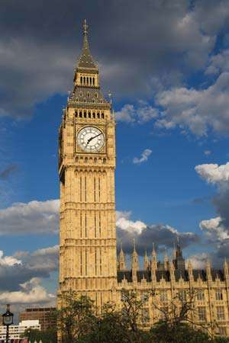
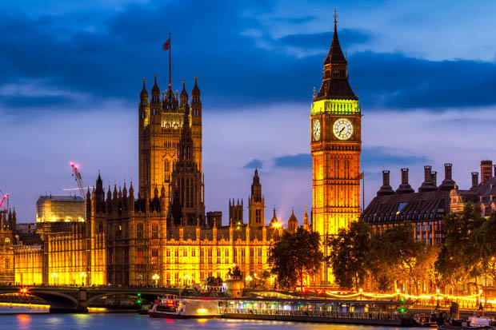
BIG BEN

Slide 5
LONDON EYE
The London Eye is a giant Ferris wheel on the South Bank of the River Thames in London. It is Europe's tallest Ferris wheel, is the most popular paid tourist attraction in the United Kingdom with over 3.75 million visitors annually, and has made many appearances in popular culture. The structure is 135 metres (443 ft) tall and the wheel has a diameter of 120 metres (394 ft). When it opened to the public in 2000 it was the world's tallest Ferris wheel. Its height was surpassed by the 525-foot (160 m) Star of Nanchang in 2006, the 165 metres (541 ft) Singapore Flyer in 2008, and the 550-foot tall (167.6 m) High Roller (Las Vegas) in 2014. The London Eye offered the highest public viewing point in London until it was superseded by the 245 metres (804 ft) high observation deck on the 72nd floor of The Shard, which opened to the public on 1 February 2013.
The London Eye adjoins the western end of Jubilee Gardens (previously the site of the former Dome of Discovery), on the South Bank of the River Thames between Westminster Bridge and Hungerford Bridge beside County Hall, in the London Borough of Lambeth.

Slide 6
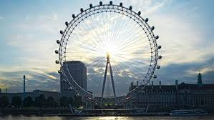
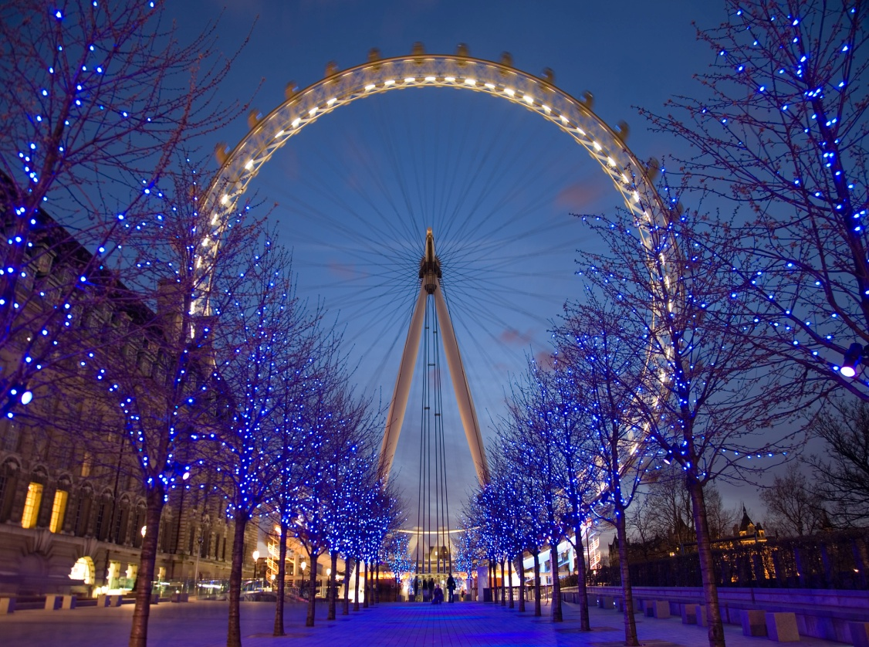
LONDON EYE

Slide 7
THANKS FOR WATCHING!!!

