Slide 1
Mentoring@sch
Onsite Event at the 10th Helioupolis Primary School
Monday, December 18th, 2017

Slide 2
What is a Mentor?
By definition, a mentor is someone who offers his/her knowledge, wisdom and advice to someone with less experience

Slide 3
Από που προέρχεται η λέξη “μέντορας”
Σύντομο θεατρικό δρώμενο από μαθητές και μαθήτριες της Δ΄τάξης

Slide 4
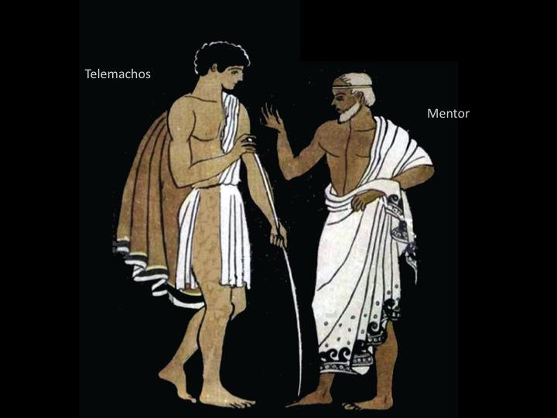
Telemachus and Mentor

Slide 5
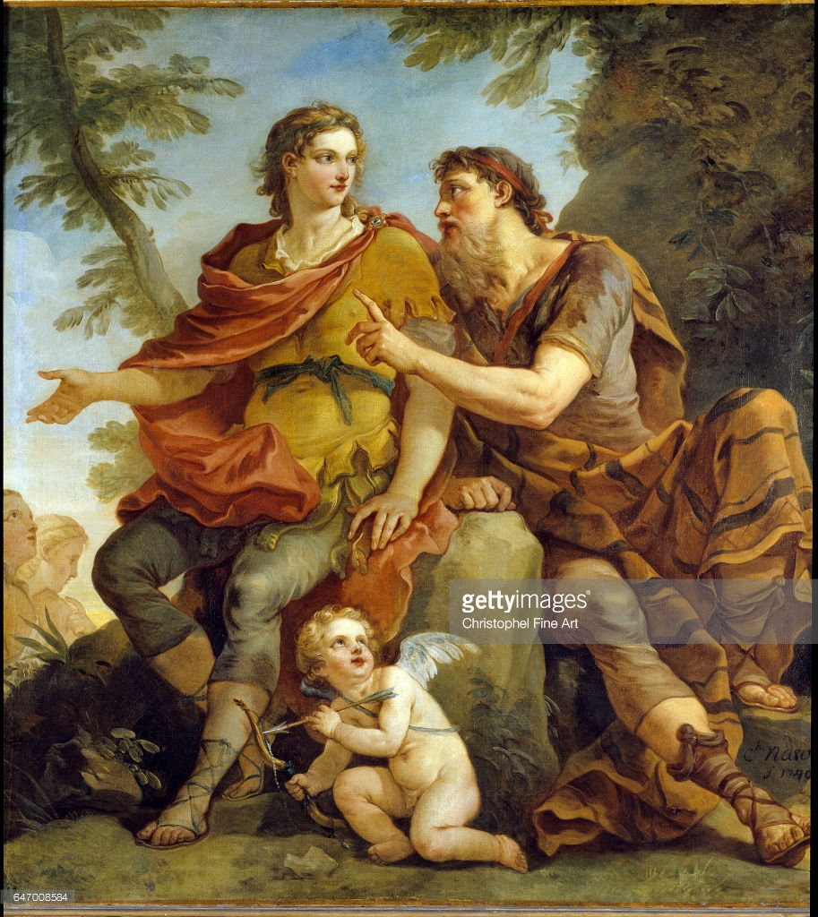
French school:
Telemachus is listening to Mentor

Slide 6
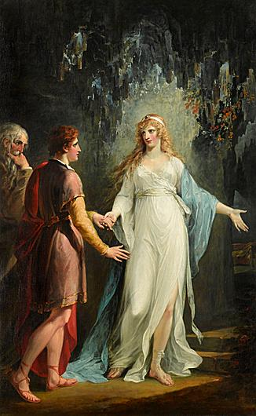
Calypso receiving Telemachus and Mentor in the Grotto

Slide 7
Mentor and Mentee
“Mentor” by Amanda Woodward

Slide 8
Mentoring Relationship

Slide 9
What does a Mentor do?

Slide 10
What is eTwinning?
Animation

