Slide 1
Mediterranean diet
Maria Protopapa
Eudokia Fokianoy

Slide 2
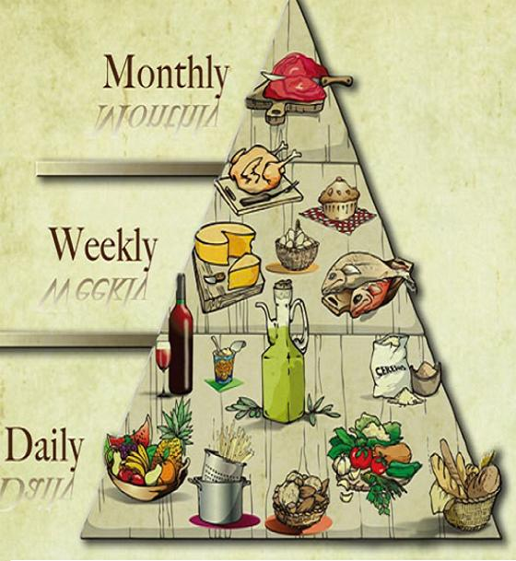
Mediterranean diet
The concept of Mediterranean diet found from Ansell Kis .
The Mediterranean diet is defiantly based on :
Many fiber(bread ,cereal , potatoes…)
Dairy products(cheese and yogurt)
Fish and chicken in small amounts.

Slide 3
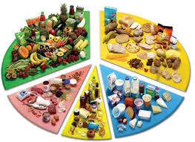
Groups of food
Milk and dairy products
Fruit and vegetables
Cereals and bread
Meat-fish- legumes
Fats and oils

Slide 4
Milk and dairy products
Milk and dairy products contain nutrients ,Vitamins A or D and iron.
Breastfeeding is good for babies.

Slide 5
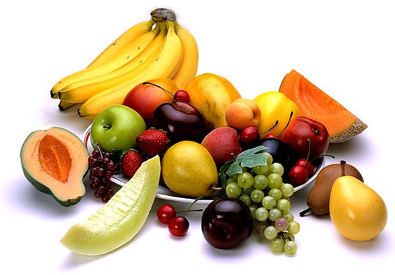
fruits and vegetables
The fruits and vegetables are very healthy for our heart. Some of them are very healthy because they contain minerals and trace elements that are good for our health. For example :
The orange contains vitamin C.
People should consumes 5 servings of fruit.
People must consume
Five pods every day.

Slide 6
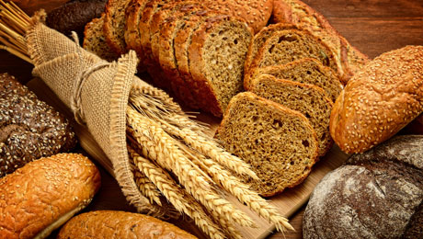
Cereals and bread
Cereals and bread are reach in fiber.
Whole grain cereals contain vitamins (B1,B2,E)
Pasta contains flour, meal , water and some of them contain egg.
Potatoes contain vitamin C and proteins
Disadvantages of frosty potatoes are get very much frosty oil.

Slide 7
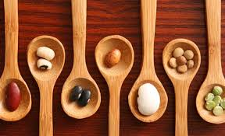
Meat- fish-pulses
Meat is a very important source of proteins and vitamins B.
Fish is very good for our eyes and is a very important source of proteins and consumes….
Pulses are very reach in starch and they are poor in fats.

Slide 8
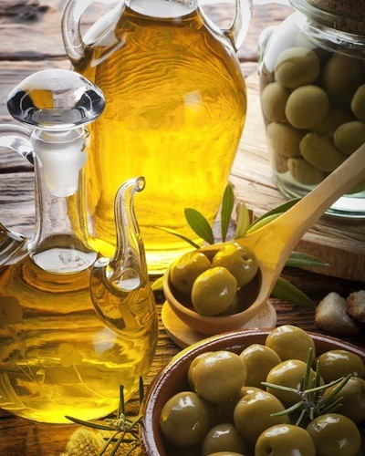
Fats and oils
They contain the important vitamins A,D,E and K
They have many calories (9Kcal/gr)
Dried fruit contain important nutrients and excellent quality of fats.

Slide 9
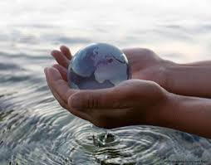
The water
The water is good for our health. We need it every day because it helps us to be healthy.
We need it for our animals and flowers to change
colours and seasons!!!!!!!!
People must drink eight glasses of
water.

Slide 10
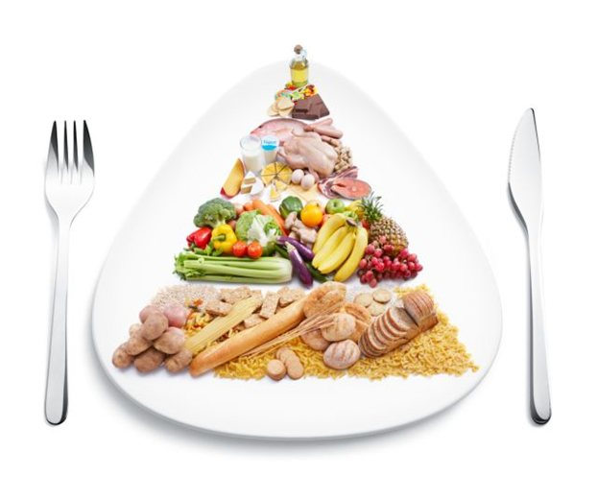
Enjoy your meal………..!!!!!

