Slide 1
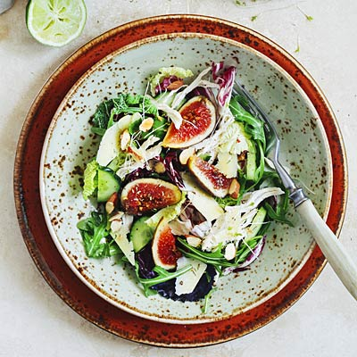
MEDITARREANEAN DIET
(Μεσογειακή διατροφή )

Slide 2
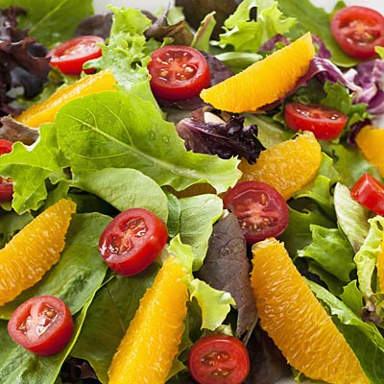
Things to know about the Mediterranean diet
At this point you probably already know that Mediterranean diet is good for your health. Research proves over and over again that people who put an emphasis on produce, fish, whole grains, and healthy fats not only weigh less, but also have a decreased risk for heart disease, depression, and dementia. So what are you waiting for? Here are the basics: Shop the market perimeter, eat seasonally, and break (whole-grain) bread with people who make you smile.

Slide 3
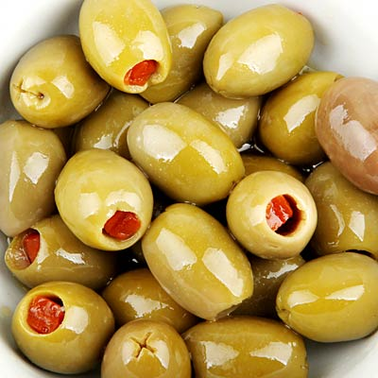
Choose healthy fats
Olives and their oil are basic; go for four to six servings per day ( a serving could be 1 tsp. of oil, 5 olives or 1/8 of an avocado ). Olive oil delivers healthy monounsaturated fats and plant compounds called polyphenols.

Slide 4
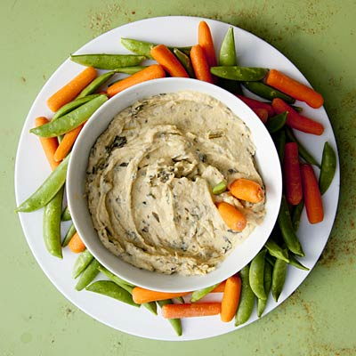
Pick seeds, nuts and legumes
These are a great source of fiber and protein;nuts and seeds also provide healthy fats and antioxidants. Eat a serving of legumes ( ½ cup, cooked )- at least twice a week and a small portion of nuts daily about 1 Tbsp., or 10 to 12 almonds or walnut).

Slide 5
Focus on fish and eggs
Aim to eat a 4-oz. serving of fish, two to three times a week. Eggs are also on the menu: Whip them into a vegetable frittata. Lean meat and chicken are OK, too, in moderation.

Slide 6
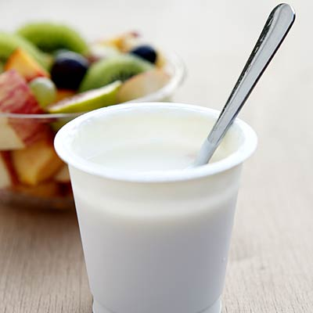
Do have (some) dairy
Work in dairy from cultured milk ( yogurt, fresh cheeses like ricotta); it's easier to digest and supplies beneficial bacteria that contribute to digestive health. Enjoy one to three servings daily (a serving is 1 cup of milk or yogurt or 1 oz. of cheese).

Slide 7
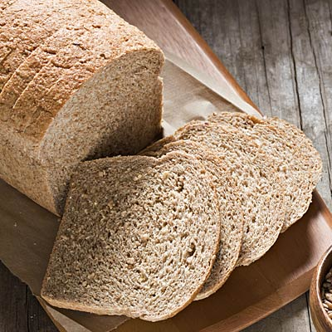
Get grain
Refined carbs lack nutrients and can cause harm to your blood sugar. Whole grains are best; have four small daily portions of whole-wheat bread. Always eat grains with healthy fats and protein, for easier digestion and better nutrient absorption

Slide 8
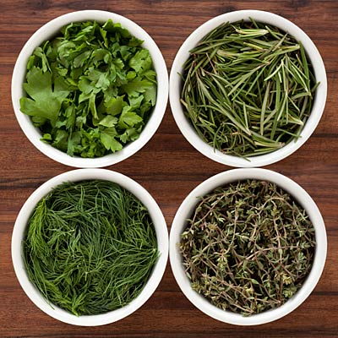
Add herbs and spices
They're full of plant compounds with antioxidant and inflammation-fighting effects

Slide 9
Rethink what you drink
Drink water as much as you can. Many Mediterraneans sip espresso after meals to aid digestion. In North Africa and Europe during the last years, they choose antioxidant-rich green tea combined with mint for the same reason.

Slide 10
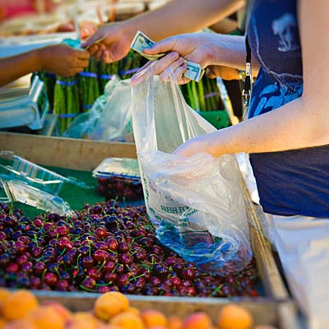
Eat locally
By following the seasons, you'll broaden the range of nutrients you take in over the year.

Slide 11
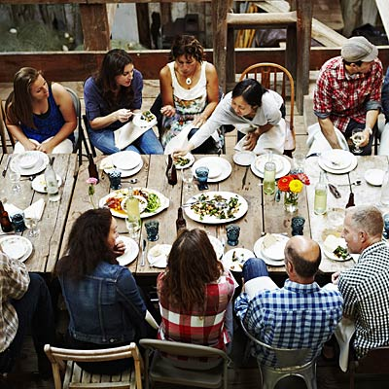
Make it social
Relaxed meals with family and friends are a central part of life in the town. This positive attitude toward eating helps improve digestion and lower stress, too.
Panagiotis Papageorgiou
&
Christos Banoulas

