Slide 1
Food idioms!!!
In this project, we will present idioms and expressions in English related to food. Food idioms can be found in many languages, and they are closely related to culture. Here are some of the funniest!

Slide 2
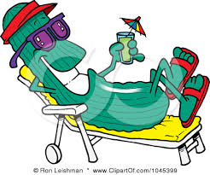
As cool as cucumber: you’re not getting worried about anything, feeling relaxed.
Ex. Although he was expelled from school, Jim came home as cool as cucumber

Slide 3
Go bananas: getting excited or anxious about something

Slide 4
`
Bread and butter: the basic needs of life.
Ex. Most people are worried about bread and butter issues, such as jobs and taxes.

Slide 5
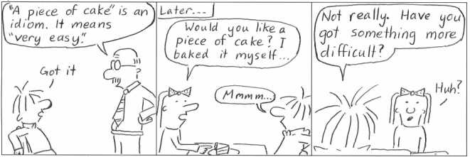
Piece of cake: very easy to do
ex. This math homework is a piece of cake, I can finish it in 5 minutes.

Slide 6
As easy as apple pie: very easy ex. The test I wrote yesterday was as easy as apple pie.

Slide 7
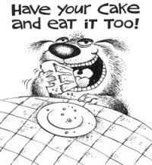
Have one’s cake and eat it too: have something both ways
ex. I wanted to have my cake and eat it too when I wanted more holidays and less homework at school.

Slide 8
It’s not my cup of tea: I don’t like something ex. Going to art galleries is not my cup of tea, so I think I’ll stay at home tonight.

Slide 9
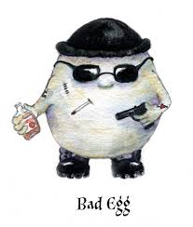
Bad egg: bad person ex. My neighbour is a bad egg and you should avoid him.

Slide 10
Have bigger fish to fry: have more important things to do.

Slide 11
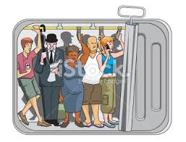
Packed in like sardines: packed in very tightly ex. The commuters were packed in like sardines in the subway car.

Slide 12
For peanuts: for almost nothing
ex. I was able to buy a used laptop for peanuts.

Slide 13
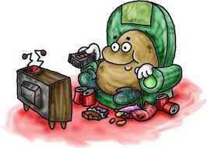
Couch potato: somebody who spends a lot of time on a couch watching tv.
Ex. Smith is a couch potato and he never wants to help with the chores.

Slide 14
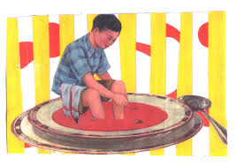
In the soup: in serious trouble ex. The woman is in soup now, as she told her boss she was sick but was seen downtown shopping.

Slide 15
Duck soup: a task that does not require much effort. ex. This school project about food idioms was like duck soup.

Slide 16
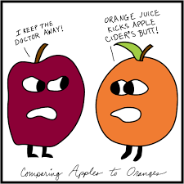
Compare apples and oranges: compare things that are not similar.
ex. It was like comparing apples and oranges when we compared our new English teacher to our old one.

Slide 17
buy a lemon: buy something worthless. ex. I think I bought a lemon with that used car I bought last week.

Slide 18
as sweet as honey: very sweet.
ex. My best friend is as sweet as honey. Everybody likes her.

Slide 19
Do the following quiz to find out how good is your food-idiom intuition!!!
Quiz
How did you do with the quiz???
We hope this project has given you food for thought , that is something to think about and , as a reward for your time , here’s a funny song about food and health!!!
healthy food will make you smile :) !!!

Slide 20
MIKE PAPAZAFIROPOYLOS
EVA TSIOLAKI
THE END!!!!!!!!!!!!!! <3

